Slide 1
TOPIC 3
Monitoring Jobs & Unemployment
Chapter 22
Michael Parkin

Slide 2
Objectives
After studying this chapter, you will be able to:
Explain why unemployment is a problem
Define unemployment rate, employment-to-population ratio and labor force participation rate
Describe the trends and cycles in these labor market indicators
Explain why unemployment is an imperfect measure of underutilized labor and why it is present in full employment
Understand how unemployment and real GDP fluctuate together over a business cycle.

Slide 3
Why Unemployment Is a Problem?
Unemployment results in
Lost incomes and production: The loss of income is devastating for those who bear it. Employment benefits create a safety net but don’t fully replace lost wages, and not everyone receives benefits.
Lost human capital: Prolonged unemployment permanently damages a person’s job prospects by destroying human capital.
.

Slide 4
Employment and Unemployment
The population is divided into two groups:
The working-age population/adult population—the number of people aged 16 years and older who are not in jail, hospital, or some other institution
2. People too young to work (under 16 years of age) or in institutional care

Slide 5
Employment and Unemployment
The working-age population is divided into two groups:
People in the labor force
People not in the labor force
The labor force is the sum of employed and unemployed workers.

Slide 6
Employment and Unemployment
To be counted as unemployed, a person must be in one of the following three categories:
Without work but has made specific efforts to find a job within the previous four weeks
Waiting to be called back to a job from which he or she has been laid off
Waiting to start a new job within 30 days

Slide 7
Labor Market Indicators
The Census Bureau calculates three indicators of the state of the labor market. They are:
The unemployment rate
The employment-to-population ratio
The labor force participation rate

Slide 8
Labor Market Indicators
1. The Unemployment Rate
The unemployment rate is the percentage of the labor force that is unemployed.
The unemployment rate is (Number of people unemployed ÷ labor force) × 100.
In June 2010, the labor force was 153.7 million and 14.6 million were unemployed, so the unemployment rate was 9.5 percent.
The unemployment rate increases in a recession and reaches its peak value after the recession ends.

Slide 9
Labor Market Indicators
2. The Employment-to-Population Ratio
The employment-to-population ratio is the percentage of the working-age population who have jobs.
The employment-to-population ratio is (Employment ÷ Working-age population) × 100.
In June 2010, the employment was 139.1 million and the working-age population was 237.7 million.
The employment-to-population ratio was 58.5 percent.

Slide 10
Labor Market Indicators
3. The Labor Force Participation Rate
The labor force participation rate is the percentage of the working-age population who are members of the labor force.
The labor force participation rate is (Labor force ÷ Working-age population) × 100.
In 2008, the labor force was 154.6 million and the working-age population was 233.8 million.
The labor force participation rate was 66.1 percent.

Slide 11
Labor Force Statistics
Working age/Adult Population can be divided into 3 groups:
Employed: paid employees, self-employed, and unpaid workers in a family business
Unemployed: people who were available and not working but who have looked for work during previous 4 weeks
Not in the labor force: those who do not fit either any of the above two categories. i.e. full-time student, homemaker, or retiree
The labor force is the total # of workers, including the employed and unemployed.

Slide 12
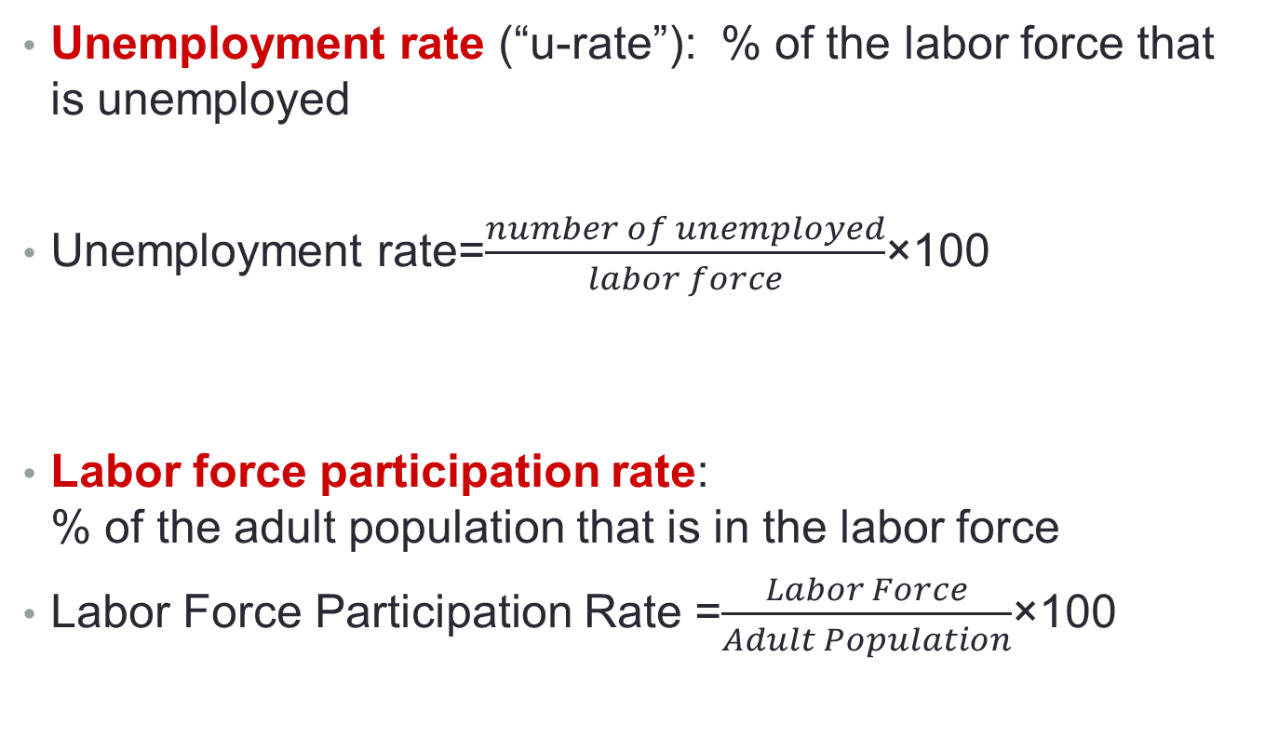
Labor Force Statistics
Unemployment rate (“u-rate”): % of the labor force that is unemployed
Unemployment rate=$\frac{number of unemployed}{labor force}$×100
Labor force participation rate: % of the adult population that is in the labor force
Labor Force Participation Rate =$\frac{Labor Force}{Adult Population}$×100

Slide 13
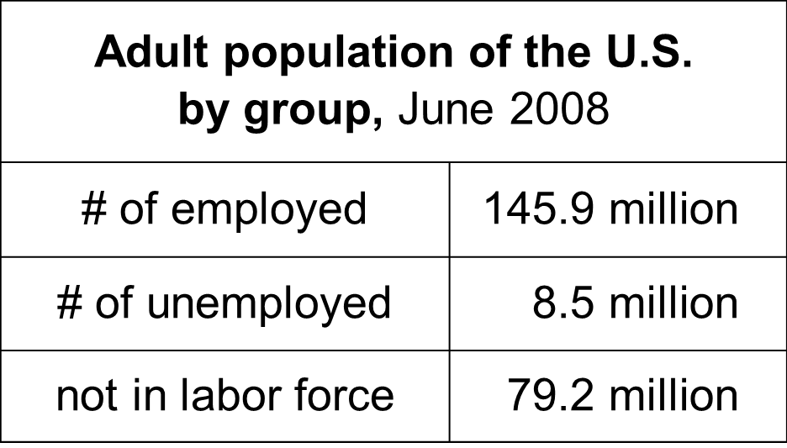
Unemployment calculation
Compute the labor force, unemployment rate, adult population, and labor force participation rate using the following data:

Slide 14
Unemployment calculation
Labor force = employed + unemployed = 145.9 + 8.5 = 154.4 million
Unemployment rate = 100 x (unemployed)/(labor force) = 100 x 8.5/154.4 = 5.5%
Population = labor force + not in labor force = 154.4 + 79.2 = 233.6 million
Labor Force participation rate = 100 x (labor force)/(population) = 100 x 154.4/233.6 = 66.1%

Slide 15
Types of Unemployment
Unemployment can be classified into three types:
Structural unemployment
Frictional unemployment
Cyclical unemployment
1. Frictional Unemployment
Frictional unemployment is unemployment that arises from normal labor market turnover.
The creation and destruction of jobs requires that unemployed workers search for new jobs.
Increases in the number of people entering and reentering the labor force and increases in unemployment benefits raise frictional unemployment.
Frictional unemployment is a permanent and healthy phenomenon of a growing economy.

Slide 16
Types of Unemployment
2. Structural Unemployment
Structural unemployment is unemployment created by changes in technology and foreign competition that change the skills needed to perform jobs or the locations of jobs.
Structural unemployment lasts longer than frictional unemployment.
3. Cyclical Unemployment
Cyclical unemployment is the higher than normal unemployment at a business cycle trough and lower than normal unemployment at a business cycle peak.
A worker laid off because the economy is in a recession and is then rehired when the expansion begins experiences cycle unemployment.

Slide 17
Natural Unemployment
Natural unemployment is the unemployment that arises from frictions and structural change when there is no cyclical unemployment.
Natural unemployment is all frictional and structural unemployment.
The natural unemployment rate is natural unemployment as a percentage of labor force.
Full employment is defines as the situation in which the unemployment rate equals the natural unemployment rate.
When the economy is at full employment, there is no cyclical unemployment or, equivalently, all unemployment is frictional and structural.

Slide 18

Practice Question
Adult population of Bangladesh by group
No. of employed 125.8 million
No. of unemployed 10.9 million
Not in labor force 79.2 million
Calculate the unemployment rate and labor force participation rate

